Slide 1


AI
ASSGINMENT-3
Sonith(CS22B036) & Veerain(CS22B049)

Slide 2
♟️EVALUATION FUNCTION
MATERIAL: WEIGHTED SUM OF PIECES (PAWN=100, KNIGHT=320, ...).
CENTRAL CONTROL: +10 BONUS FOR PIECES ON D4, D5, E4, E5.
MOBILITY: ±0.2 × LEGAL MOVES (BASED ON TURN).
REPETITION PENALTY: −500 IF LAST 4 MOVES UNDO EACH OTHER.
KING SAFETY: +30 IF PLAYER HAS CASTLING RIGHTS, −30 IF OPPONENT DOES.
_IS_REPETITION(BOARD):
CHECKS IF BOTH PLAYERS REVERSED THEIR MOVES IN LAST 4 PLIES.

Slide 3
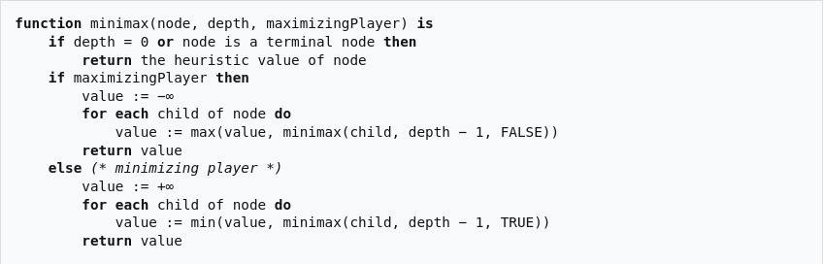
MINMAX
Why It Works Like This
Shallow Lookahead: Depth 3 only predicts short-term consequences, missing long-term traps or opportunities.
Full Tree Exploration: No Alpha-Beta Pruning — wastes time evaluating obviously bad moves too.
Deterministic Behaviour: Always plays the move it predicts to be best after 3 plies, making its play predictable.

Slide 4
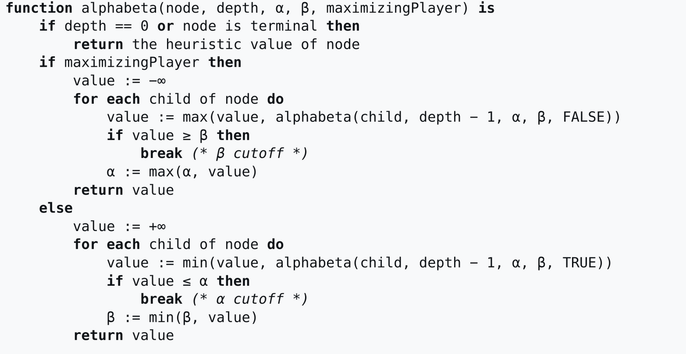
ALPHA BETA PRUNING
WHY IT WORKS
EVAL FUNCTION: SCORES POSITIONS FAST USING MATERIAL, CENTER CONTROL, MOBILITY, REPETITION, AND KING SAFETY.
ALPHA-BETA PRUNING: SPEEDS UP MINIMAX BY SKIPPING BAD BRANCHES, ALLOWING DEEPER SEARCH.
MOVE ORDERING: PRIORITIZES CAPTURES/CHECKS → BETTER PRUNING → SMARTER DECISIONS.
ASYMMETRIC DEPTH: BLACK SEARCHES DEEPER → MORE CHALLENGE; WHITE PLAYS FASTER.
RENDERING: TURNS BOARD STATES INTO FRAMES → COMPILES INTO A VIDEO.

Slide 5
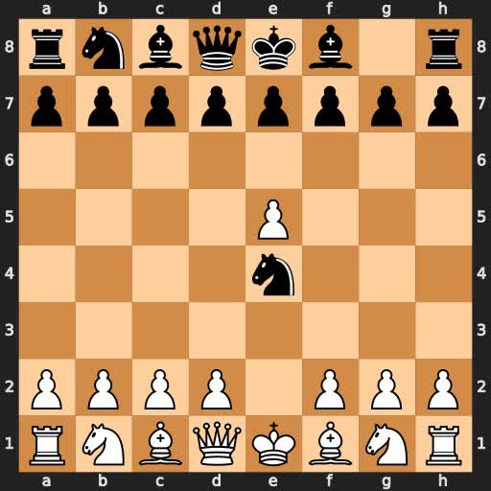
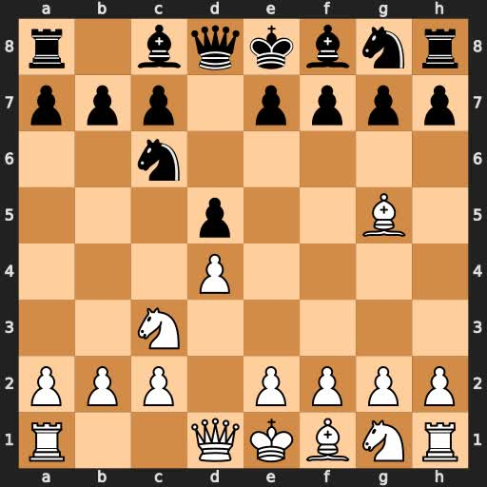
ALPHA-BETA PRUNING VIDEO
MINMAX VIDEO

Slide 6
THANK YOU!

